Slide 1
Reviews & Rating Sentimental Analysis
In this task we need to create dataset of reviews & ratings of multiple projects & then we need to perform EDA & modelling to understand the public sentiment towards the products

Slide 2
Steps taken before EDA was performed
Created the dataset using webscraping
Imported necessary libraries for task to be completed
Loaded dataset on jupyternotebook using pandas library
We also checked dimension of the dataset & we get to know that dataset contains 24118 rows & 2 columns
There were 2 null values present in the dataset & we filled them randomly
Performed various prerocessing operation on review column of dataset like applying stopwords, tokenization, lemmatization, etc of the column.
Then we created a new column named word_count in which the number of words of paragraphs were counted.

Slide 3
Exploratory Data Analysis

Slide 4
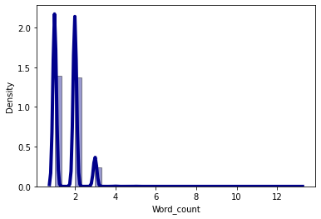
1. Word_count
There were no null values present in it
From visualization we concluded that most paragraphs or sentences have only one word or two words in them

Slide 5
Applying model & checking the performance
We performed vectoreization of dataset & splitted it into train & test set
We then applied random forest classification & Logistic Regression models on it.
Accuracy of both models were coming out the same.
So we randomly chose Random Forest Classification model & saved it using pickle library

